Slide 1
LLM-BASED THREAT HUNTING
A Natural-Language Investigation Engine, Built on Live Splunk Telemetry
From a synthetic prototype to real endpoint data — what I built, what I hit, and what I fixed.
Personal Project

Slide 2
WHAT I BUILT
A natural-language threat hunting engine on real SOC data
Hybrid NL → SPL engine
Safety-checked AI queries
One-click investigation chain
Deterministic regex parser for known patterns + a local LLM (Llama 3.2 via Ollama) for open-ended questions.
Every LLM-generated query is validated against a destructive-command blocklist before it ever runs.
Automatically walks failed logins → successful compromise → process activity → network connections.
Real endpoint validation
Adjustable time ranges
Interactive dashboard
Re-pointed the whole pipeline at live Windows Security Event Log + Sysmon data — not just synthetic test data.
Last 24 hours / 7 days / 30 days / All time — for both single questions and full investigations.
A Streamlit UI showing the generated query and results side by side, fully transparent.

Slide 3
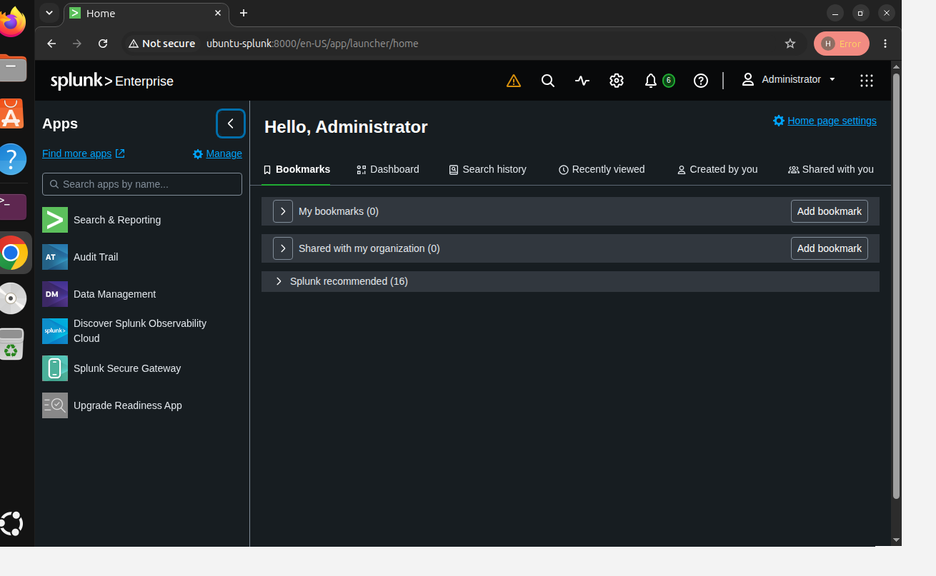
REAL DATA, NOT JUST A DEMO
Connected straight to live Splunk telemetry
Splunk Enterprise indexing real Windows Security Event Log and Sysmon data from an actual monitored endpoint — the same pipeline that started on synthetic data, now running on the real thing.
Splunk Enterprise, indexing live endpoint telemetry.

Slide 4
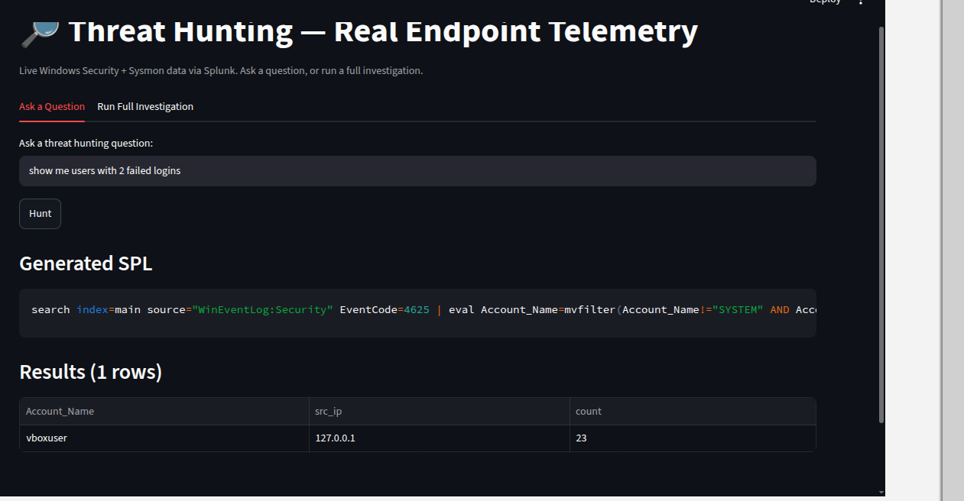
CORE ENGINE
Plain English in, real SPL out
Type a question like “users with more than 2 failed logins” and get back the actual translated SPL query plus real results — no query language required, and the reasoning path (regex vs. LLM) shown transparently.
A real question, translated and executed live against Windows Security Event Log data.

Slide 5
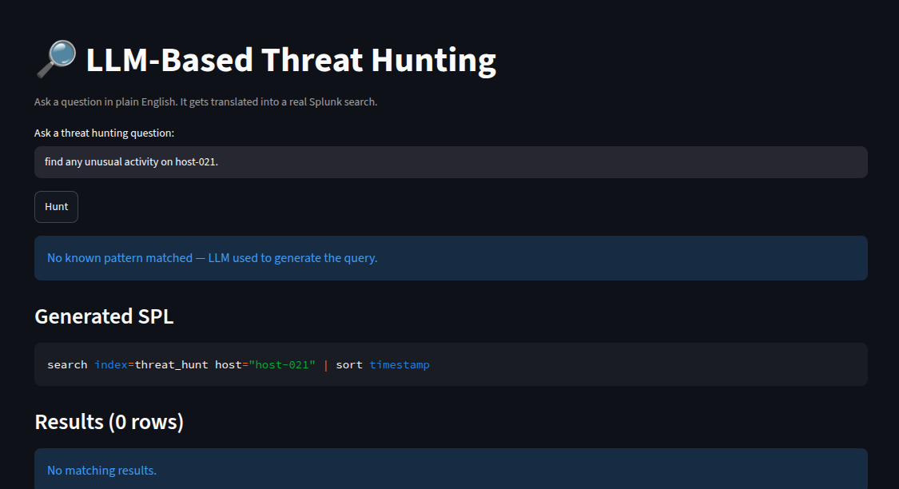
AI REASONING
A local LLM handles what the rules can't
Open-ended questions fall back to a locally-hosted Llama 3.2 model, with a strengthened prompt so it correctly attends to specific hosts and entities named in the question instead of defaulting to a generic example.
The LLM fallback correctly generating SPL for a free-form question.

Slide 6
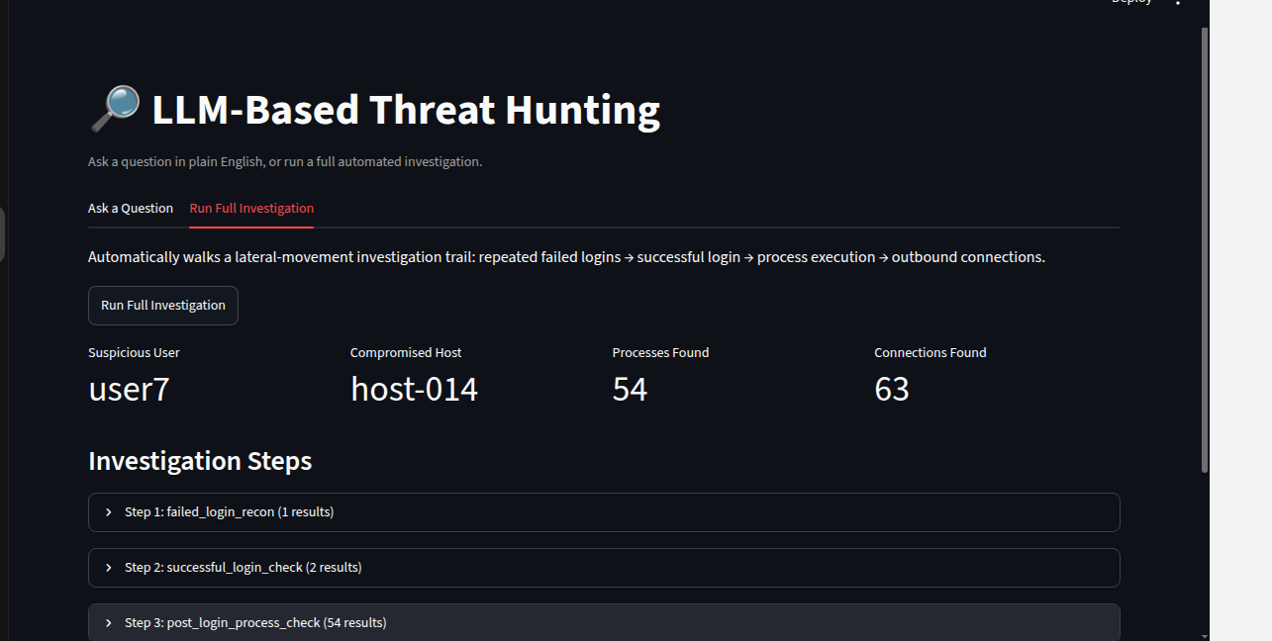
AUTOMATION
One click, four chained queries, one attack story
The investigation tab runs a fully automated chain — failed logins, successful compromise, follow-on process activity, outbound connections — recovering the full narrative without writing a single query by hand.
The automated investigation chain running end-to-end through the dashboard.

Slide 7
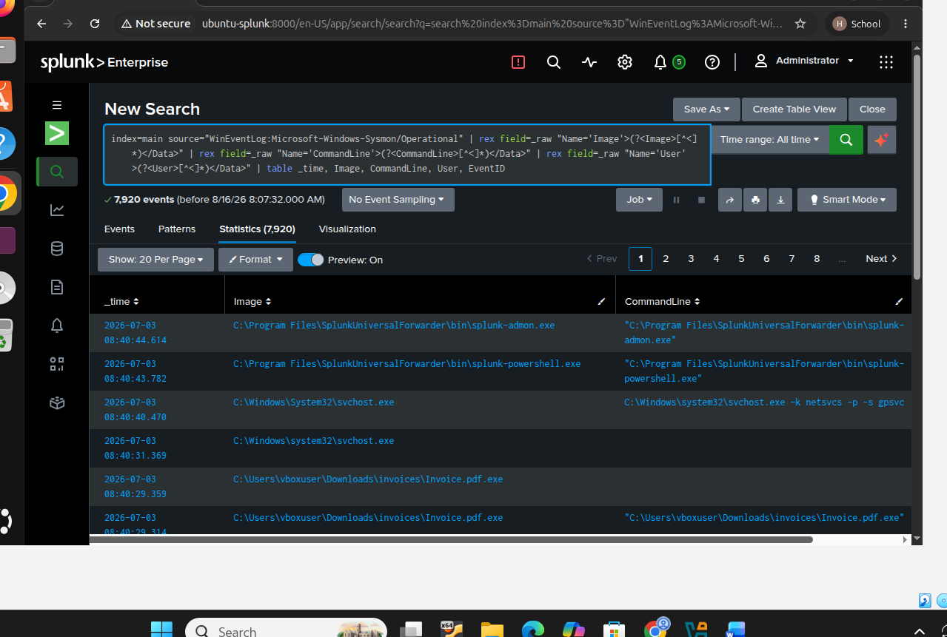
REAL FINDING
Found a genuinely disguised executable
Not a planted scenario — a real file discovered on the monitored machine: 'Invoice.pdf.exe', a classic double-extension trick used to disguise malware as a harmless PDF.
Real Sysmon telemetry surfacing a real disguised executable.

Slide 8
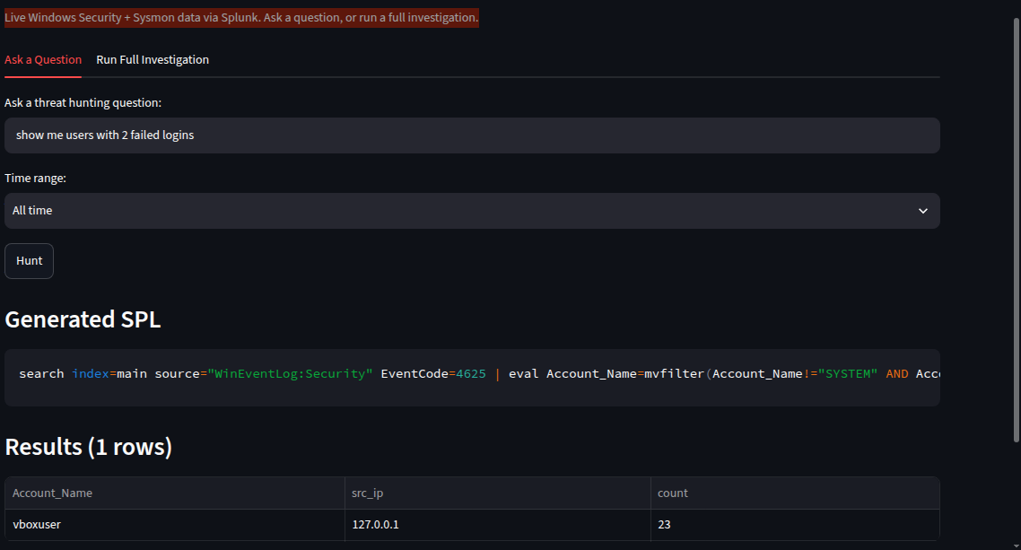
FEATURE
Every hunt is scoped to a time range
Last 24 hours, 7 days, 30 days, or all time — selectable for any question or full investigation, so hunts stay fast and relevant instead of scanning the entire history every time.
The time range selector, live on a real query returning 23 genuine failed login attempts.

Slide 9
WHAT I DIDN'T BUILD (YET)
Honest limitations, not hidden ones
Static investigation chain
The chain follows a fixed sequence rather than reasoning dynamically about what to check next — true agentic reasoning is the natural next step.
Single-endpoint scope
Validated against one monitored machine; multi-host lateral-movement detection needs forwarders on additional endpoints.
Small-model ceiling
The 1B-parameter local LLM is solid for simple lookups but not fully reliable on complex multi-step questions.

Slide 10
WHAT I RECOVERED
Real bugs, found and fixed on real data
✓
Splunk's reserved 'host' field was silently overwriting a custom schema field — renamed it, fixed for good.
✓
Windows' multivalue Account_Name field buried real users under noisy machine accounts — cleaned with mvfilter.
✓
Splunk's automatic XML extraction failed silently on Sysmon data — replaced with targeted regex extraction.
✓
The LLM defaulted to example values instead of the question's actual entities — fixed with a stronger prompt.
Every one of these came from testing against real data — not something synthetic data would have caught.

